Slide 1

Module 8: Final Course Project

Slide 2

Introduction
Hello my name is Brady Sisk, this presentation will cover the projects I completed and my experience in the CEIS101 Course.
Things like working in Tinkercad and learning how to build a circuit.
To building a full-blown security system and learning all the inner working along the way
And of course, the challenges that I faced on this fun and wiry journey.

Slide 3
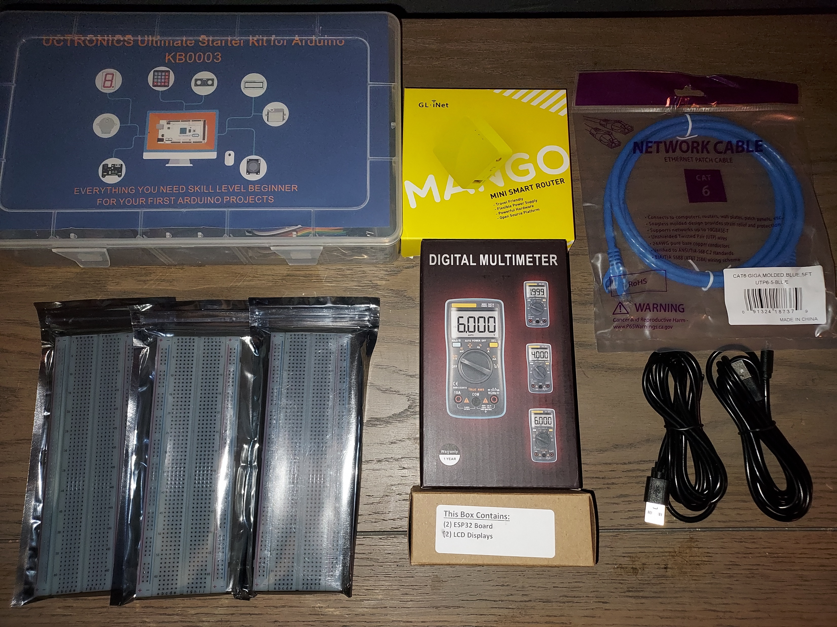
Inventory

Slide 4
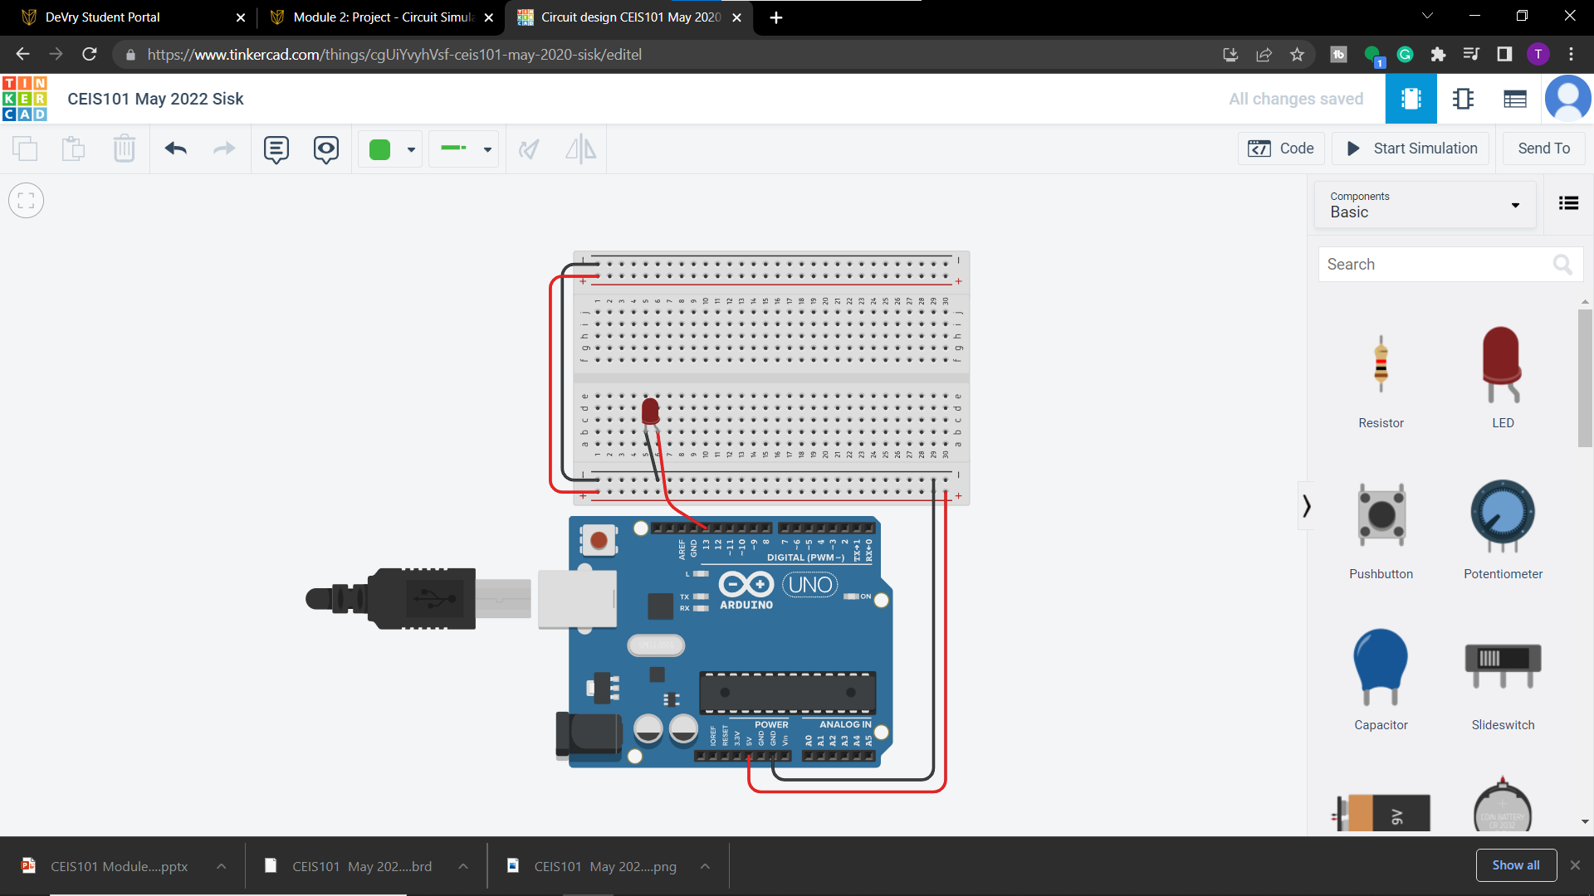
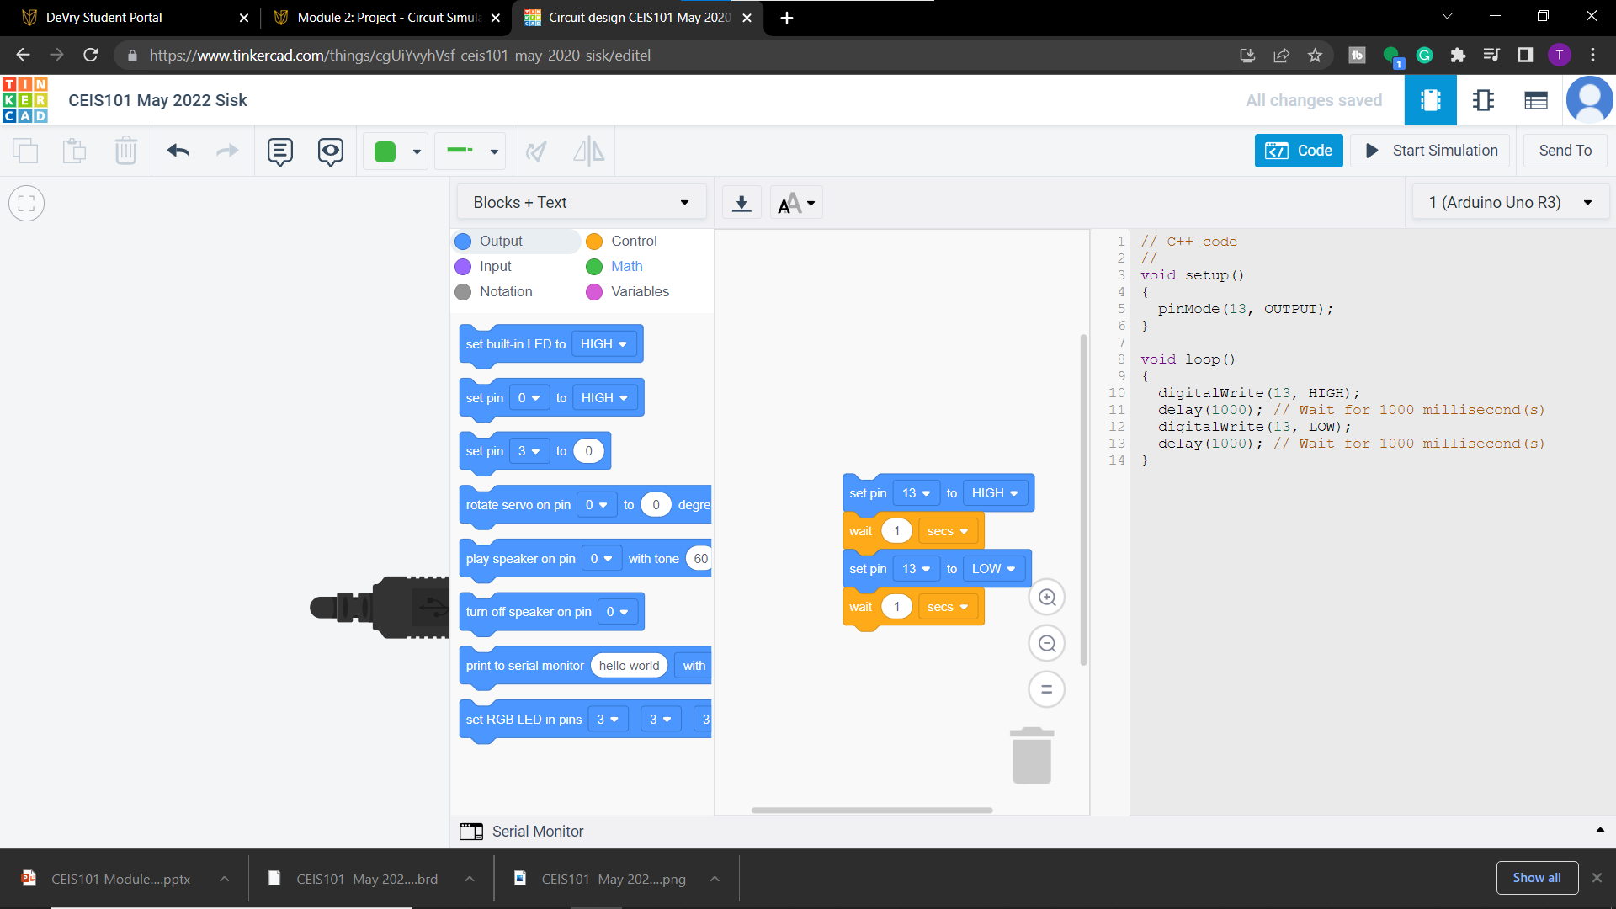
Tinkercad Circuit and Code
In the begging stages we familiarized ourselves with the coding and circuits

Slide 5
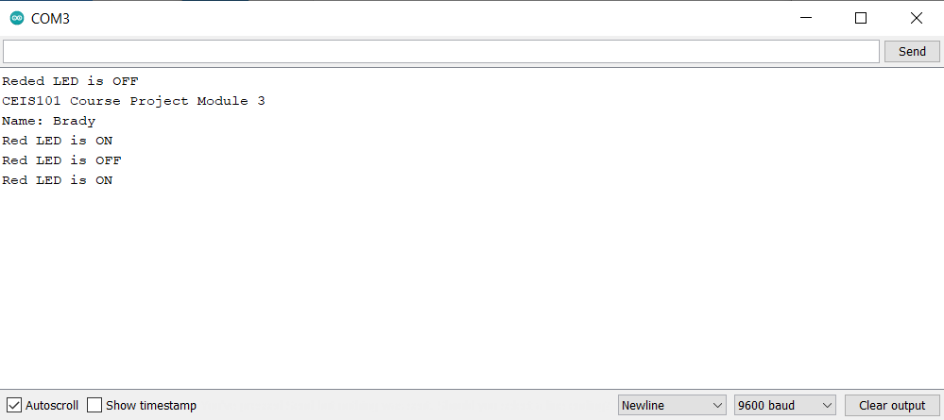
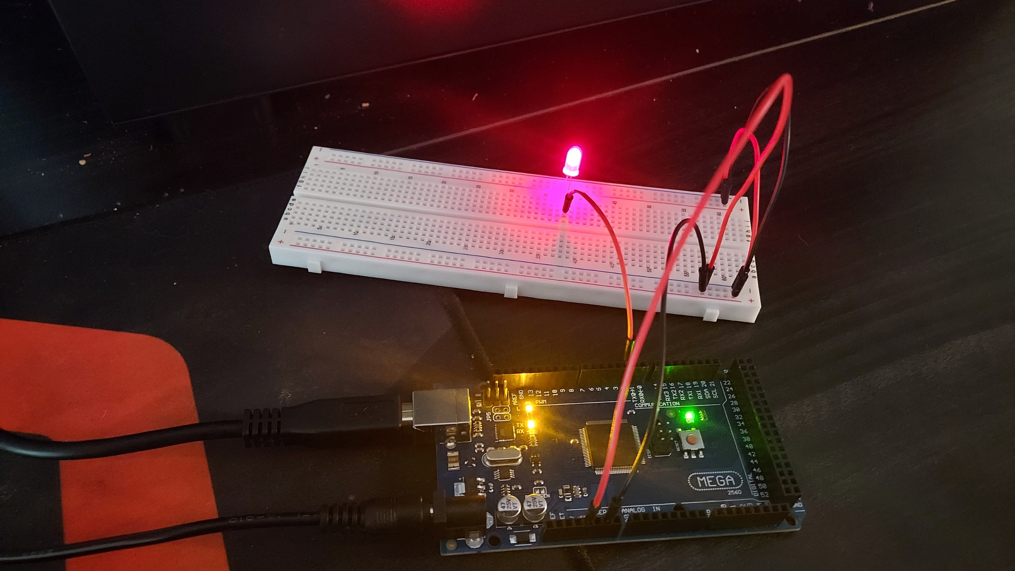
Single LED
1st part of the project was to make a single LED light up and learn the process of building a circuit.

Slide 6
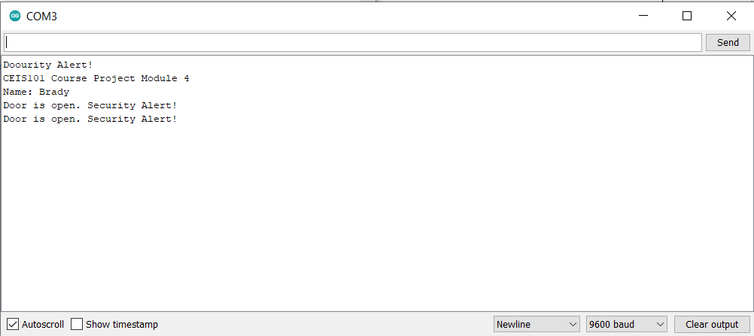
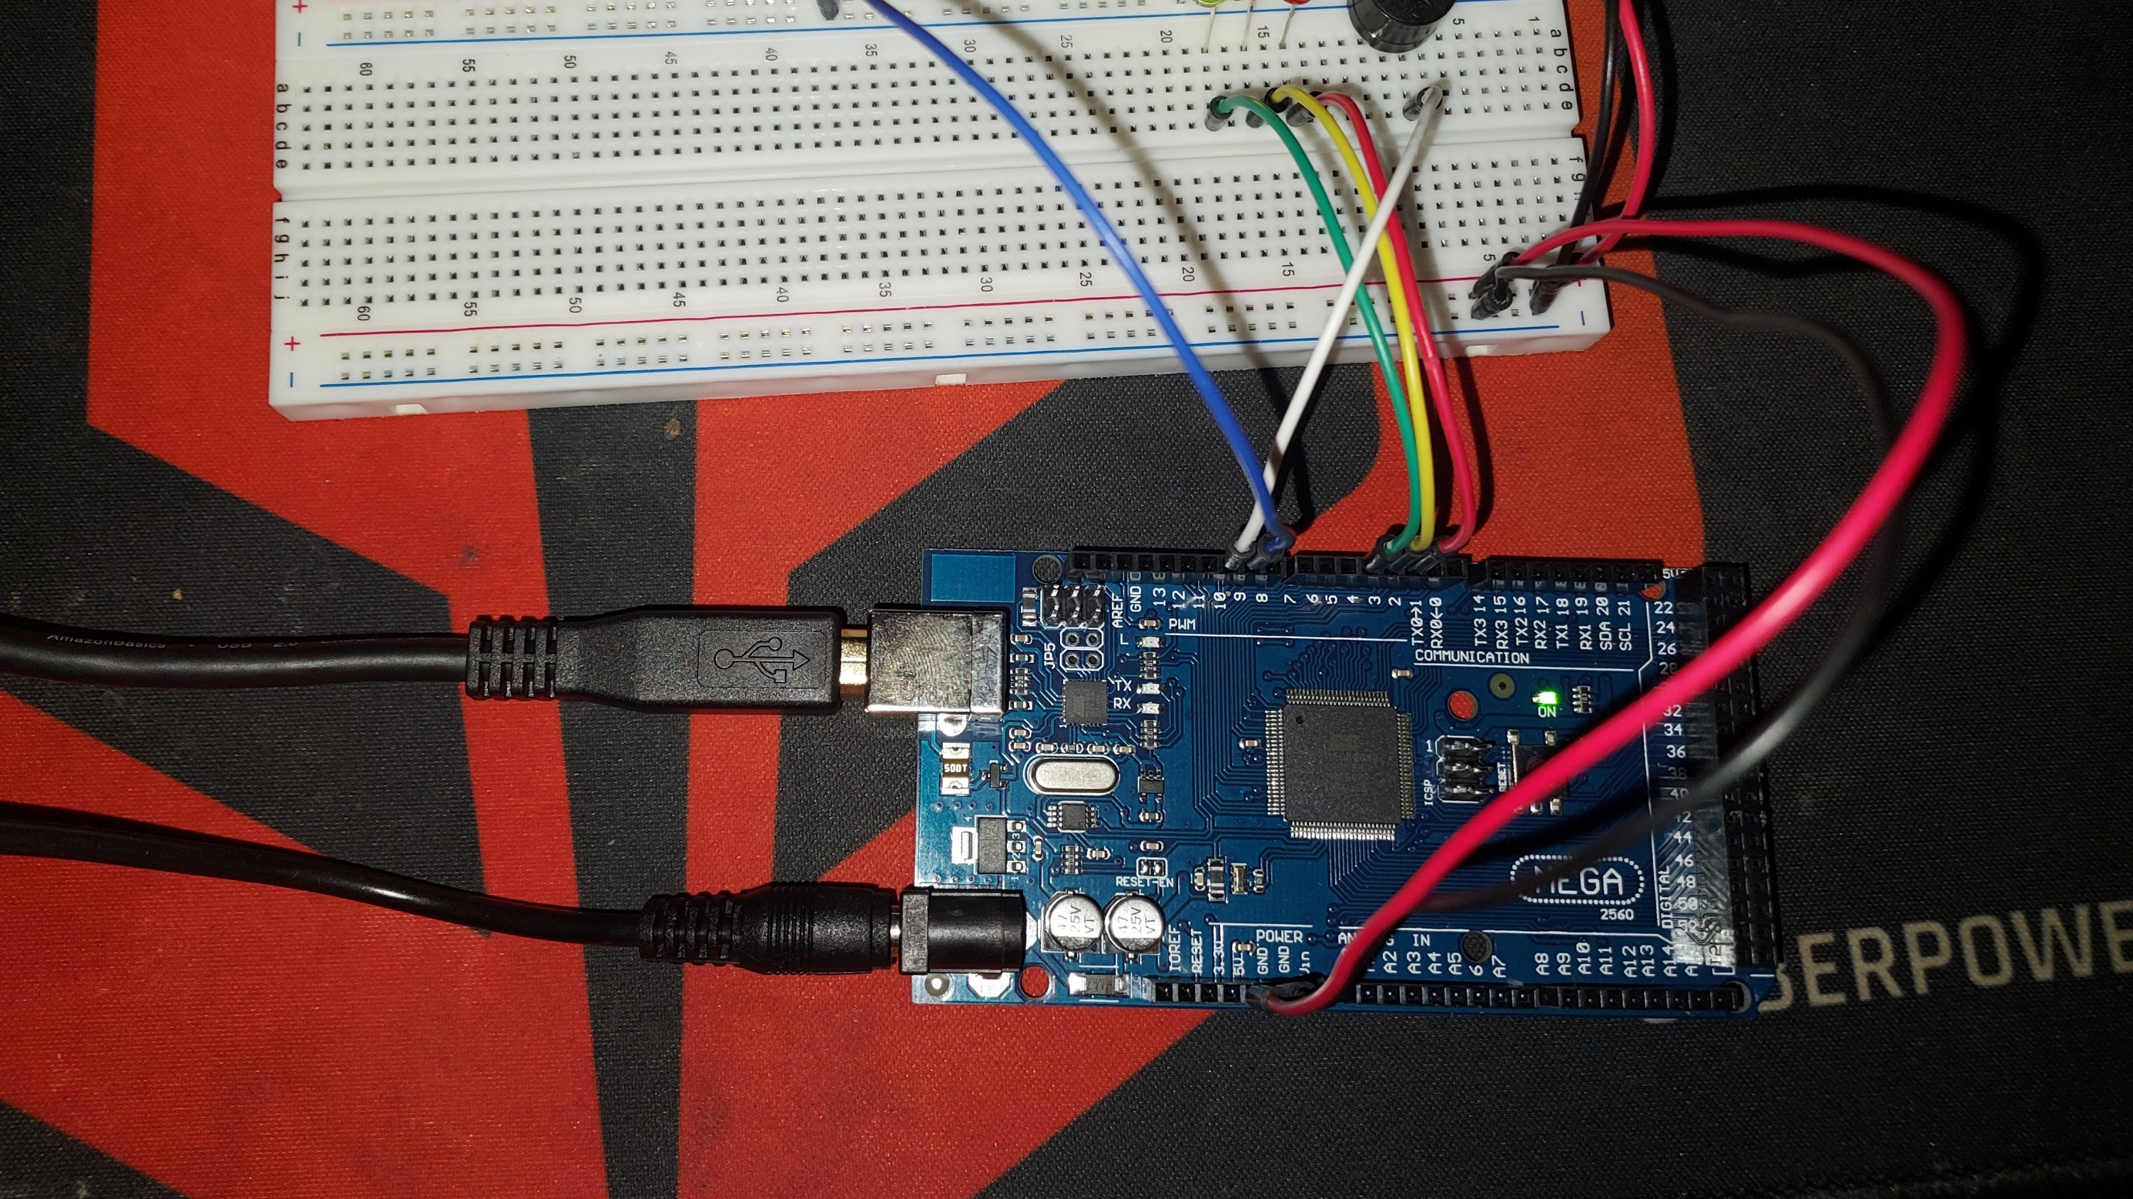
Door Sensor
2nd part was to add a yellow and a green LEDs along with a sensor that would detect whether the door was open or closed. Depending on the position of the door certain LEDs would light up.

Slide 7
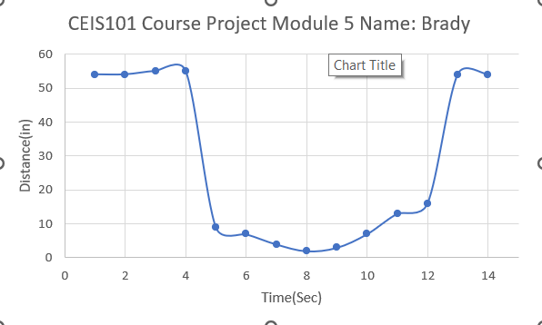
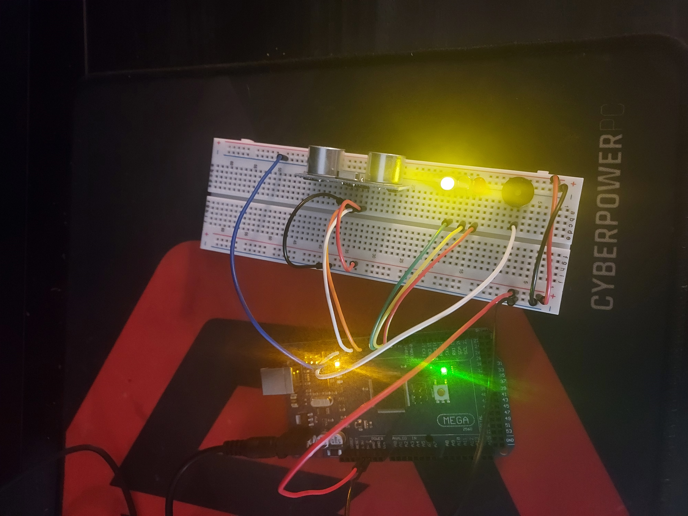
Distance Sensor
3rd part was to add a ultrasonic sensor that would change the LEDs according to how close or far away something.

Slide 8
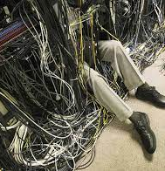
Challenges
Just like any time you are learning something new it comes with its own challenges and learning curve, some of those challenges were…
The fine detail, on one of the modules I couldn’t get my door alarm buzzer to go off. I couldn’t figure it out until I went back from scratch and saw I put a wire in the wrong the place.
So many wires, granted it makes more sense the more you do it but this picture on the left is what I envision my future looking like.
In the next slide I started to realize just how cluttery it can be.

Slide 9
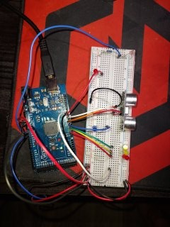
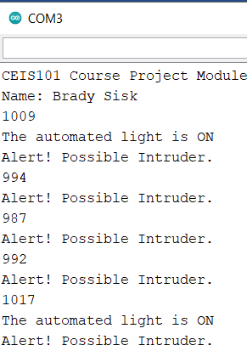
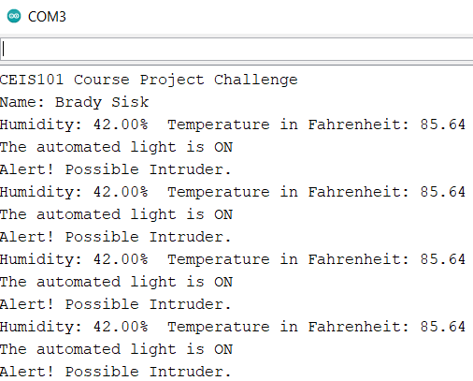
4th and final was to add a photoresistor and resister in series to detect the intensity of light, based on the voltage a blue LED will turn on or off. Also added a water lever sensor and a DHT-11 sensor to detect temperature, humidity, and flooding
Automated Light/
Water level sensor

Slide 10

Career Skills
The goal is to become an Ethical Hacker
Description:
They are employed to legally break into computers and networks to test an organization's overall security. Ethical hackers possess all the skills of a cyber criminal but use their knowledge to improve organizations rather than exploit and damage them.
Salary:
80K to 130K
Characteristics:
An ethical hacker needs passion and excellent skills when it comes to understanding technology. A hacker needs to be the best at what he or she does. In-depth knowledge of networking, hardware, software, and programming is pre-requisite for any kind of hacking, ethical or otherwise

Slide 11
Conclusion
To bring this presentation to a close, the projects were all functional and working correctly. I learned so much from this course, through the challenges and assignments.
If you would like to see more of my projects you can go to the link at the bottom. Thank you for your time and hope you found my journey insightful and interesting.
Portfolio: https://bradysisk.github.io/

